Slide 1

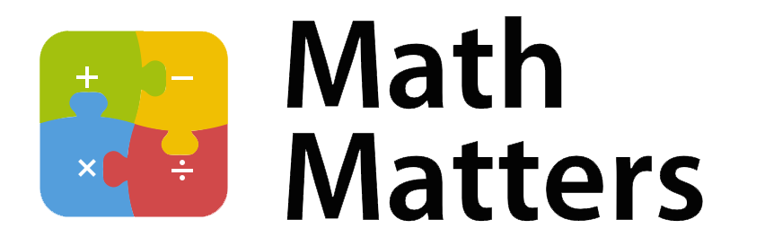
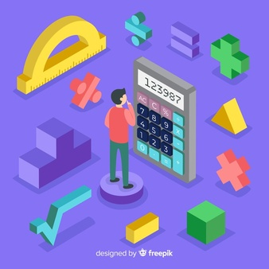
St Michael’s CE VA Primary School
Year 5
At St Michael’s CE VA Primary School our aim is to work in partnership with you to enhance your child’s progress and enjoyment of Maths! This leaflet is an aid to help you to support your child to develop their understanding of the range of Maths concepts they will cover while in school. It aims to offer ideas of fun activities to engage your child’s love of Maths at home.

Slide 2
During Year 5 most children will learn how to:
Read, write, order, round and compare numbers up to 1, 000, 000
Count forward and back in steps of 10.
Solve problems involving numbers.
Recognise and use negative numbers in a context.
Find factors, prime numbers and prime factors of numbers.
Use square and cube numbers.
Multiply and divide whole numbers mentally.
Multiply numbers by 10, 100 and 1000.
Use written methods to multiply and divide Thousands, hundreds, tens and ones by ones.
Compare and order fractions who have denominators that are multiples of the same number (3/10, 5/15, 9/20).
Find equivalent fractions.
Multiply proper fractions and mixed numbers by whole numbers.
Read and write decimals numbers as fractions.
Read, write, order and compare numbers with up to 3 decimal places.
Write % as fractions and as decimals.
Convert between metric units of measure.
Measure and calculate the perimeter of composite shapes in cm and m.
Calculate and compare the area of rectangles.
Estimate the area, volume and capacity.
Identify 3D shapes.
Identify regular and irregular polygons related to their properties.
Estimate and compare acute, obtuse and reflect angles.
Identify angles on a line and angles around a point.
Solve problem reading, completing, and interpreting information in a line graph, tables and timetables.

Slide 3
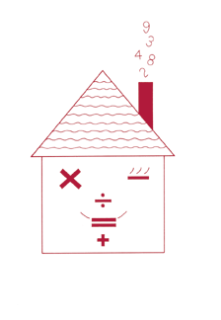
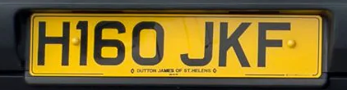

Fun activities to do at home
It is a known fact that playing card and board games can really
help children’s Maths. Adding dice scores, playing dominoes,
track or card games all help children’s Mathematics. Some of
the Year 5 objectives may be more complex then they seem. For example, a child may subtract 3994 from 9007 by writing it in columns, without realising it is quicker to count on from 3994 up to 9007 in their head. Understanding of the most efficient method and rapid recall of basic number facts is essential to create good foundations to learn future Maths concepts.
Decimal number plates
Each choose a number plate with three digits.
Choose two of the digits , e.g. 4 and 6. Make the smallest and largest numbers you can, each write 1 decimal places, e.g. 4.6 and 6.4.
Now find the difference between the two decimal numbers, e.g. 6.4 – 4.6= 1.8
Whoever makes the biggest difference scores 10 points.
The person with the most points wins.
Play the game again, but this time score 10 points for smallest difference, or 10 points for the biggest total.
Guess my number
Choose a number between 0 and 1 with one decimal place, e.g. 0.6
Challenge your child to ask you questions to guess your number. You may only answer ‘Yes’ or ‘No’. For example, they could ask questions like ‘Is it less than a half?’
See if they can guess your number in fewer than 5 questions.
Now let your child choose a mystery number for you to guess.
Extend the game by choosing a number with one decimal
place between 1 and 10, e.g. 3.6 . You may need more
questions.

Slide 4



Line it up
You need a ruler marked in centimetres and millimetres.
Use the ruler to draw 10 different straight lines on a piece of paper.
Ask your child to estimate the length of each line and write the estimate on the line.
Now give them the ruler and ask them to measure each line to the nearest millimetre.
Ask them to write the measurement next to the estimate, and work out the difference.
A difference of 5 millimetres or less scores 10 points. A difference of 1 centimetre of less scores 5 points.
How close to 100 points can he/she get?
Telephone challenges
Challenge your child to find numbers in the telephone book where the digits can be sued to make a given total, such as 42.
Find as many possible in 10 minutes using a combination of +, -, x and ÷
On another day, see if they can beat their previous total.
Favourite food
After a shopping trip ask your child the cost of a favourite item of food.
Ask them to work out what 7 of them would cost, or 8, or 9.
How much change would there be from £50?
Repeat with his/her least favourite food.
What is the difference in cost between the two?
What’s my number?
You need a set of digit cards.
Challenge your child to make and read large numbers following instructions such as these: make 34, now 234, now 2348, 23 487, 123 487, 9 123 487
Show the cards that show how many hundreds, tens, ones, millions, thousands, tens of thousands etc… there are.
Then swap different digits and say whether they number is now bigger or smaller and by roughly how much- for example, 9 123 487 swap the digits 2 and 8: the number is now bigger by roughly 60 thousand.

