Slide 1
St Michael’s CE VA Primary School
Year 4
At St Michael’s CE VA Primary School our aim is to work in partnership with you to enhance your child’s progress and enjoyment of Maths! This leaflet is an aid to help you to support your child to develop their understanding of the range of Maths concepts they will cover while in school. It aims to offer ideas of fun activities to engage your child’s love of Maths at home.

Slide 2
During Year 4 most children will learn how to:
Count from 0 in multiples of 6 , 7, 9, 25 and 1000.
Find 1000 more or less than a given number.
Count backwards through zero to include negative numbers.
Recognise the place value of each digit in a four-digit number (thousands, hundreds, tens and ones)
Order and compare numbers beyond 1000 and round any number to the nearest 10, 100 and 1000.
Add and subtract numbers with up to 4 digits using the column method.
Estimate and use the inverse operations to check answers to a calculation.
Solve addition and subtraction two-step problems deciding which operations and methods to use and why.
Use place value, known and derived facts to multiply and divide mentally, including multiplying by 0 and 1.
Multiply two digit and three digit numbers by a one digit number using the gird method.
Recognise and show, using diagrams, families of common equivalent fractions and prove equivalence by simplifying fractions.
Count up and down in hundredths.
Add and subtract fractions with the same denominator.
Calculate a fraction of a number.
Recognise and write decimals equivalence of any number of tenths and hundredths. (E.g. 71/100 = 0.71)
Recognise and write decimal equivalents to ¼, ½ , ¾
Find the effect of dividing a one digit number or two digit number by 10 and 100 and say the value of the digits in the answer.
Order, compare and round decimal numbers .
Convert between different units of measurements e.t. km to m, hours to minutes.
Measure and calculate the perimeter of a rectangle/ square.
Find the area of a rectangle by counting squares.
Estimate, compare and calculate different measures, including money in pounds and pence.
Read, write and convert time between analogue and digital 12 and 24 hour clocks.

Slide 3
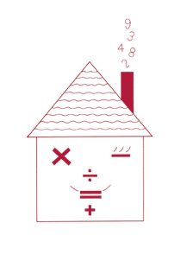
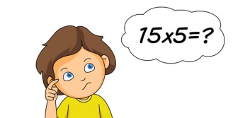
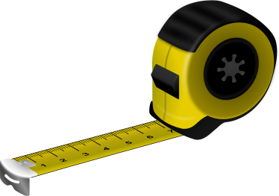
Fun activities to do at home
It is a known fact that playing card and board games can really
help children’s Maths. Adding dice scores, playing dominoes,
track or card games all help children’s Mathematics. Some of
the Year 4 objectives may be more complex than they seem. For example, children may be able to subtract 497 from506 by writing it in columns without realising it is quicker to count on from 497 up to 506 in their heads. An understanding of the most efficient method and rapid recall of basic number facts is essential to create a good foundations to learn future Maths concepts.
Times tables
Say together the six times tables forwards, then backwards. Ask your child questions, such as:
-Nine sixes? -How many sixes in 42? -Six times four?
-Forty-eight divided by six? -Three multiplied by six?
-Six times what equals sixty? -The product of six and four?
Repeat with the seven, eight and nine times tables.
Sum it up
Each player needs a dice.
Say : Go! Then each roll a dice at the same time.
Add up all the numbers showing on your own dice, at the sides as well as at the top.
Whoever has the highest total scores 1 point.
The first to get to 10 points wins.
Measuring
Use a tape measure that shows centimetres.
Take turns measuring lengths of different objects, e.g. the length of a sofa, the width of a table, the length of the bath, the height of a door.
Record the measurement in centimetres, or metres and centimetres if it is more than a metre, e.g. if the bath is 165cm long, you could say it is 1m 65cm or 1.65m.
Write all the measurements in order.

Slide 4
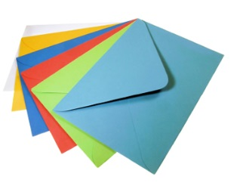
How much?
While shopping, point out an item costing less than £1.
Ask your child to work out in their head the cost of 3 items.
Ask them to guess first. See how close they come.
If you see any items labelled, for example. ‘2 for £3.50’,
ask them to work out the cost of 1 item for you, and to
explain how they got the answer.
Car numbers
Choose a car number plate with three digits.
You may add or subtract 10, 20, 30, 40, 50, 60, 70, 80 or 90.
Try to get as close as possible to 555.
Who can get closest during a week?
What would you subtract to get rid of the digit 4? 6? 5?
Finding areas and perimeters
Collect 5 or 6 used enveloped of different sizes.
Ask your child to estimate the perimeter of each one to the nearest centimetre. Write the estimate on the book.
Now measure. Write the estimate next to the measurement.
How close did your child get?
Now estimate then work out the area of each envelope.
Were perimeters or areas easier to estimate? Why?
You could do something similar using an old newspaper, e.g.
Work out which page has the biggest area used for photographs.
Choose a page and work out the total area of news stories or adverts on that page.
Perimeter = distance around the edge of a shape.
Area of a rectangle= length x breadth (width)

