Slide 1

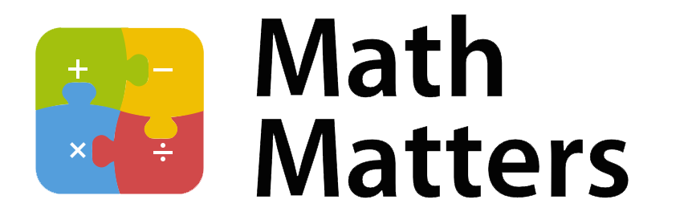
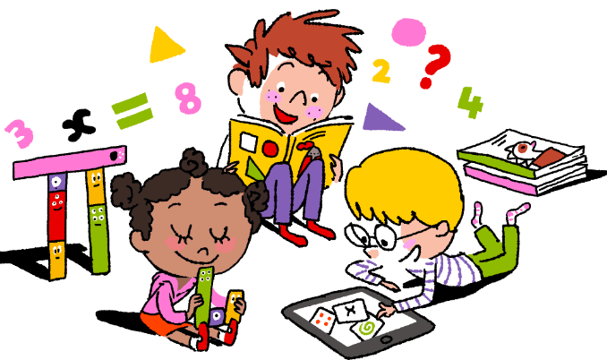
St Michael’s CE VA Primary School
Year 3
At St Michael’s CE VA Primary School our aim is to work in partnership with you to enhance your child’s progress and enjoyment of Maths! This leaflet is an aid to help you to support your child to develop their understanding of the range of Maths concepts they will cover while in school. It aims to offer ideas of fun activities to engage your child’s love of Maths at home.

Slide 2
During Year 3 most children will learn how to:
Count from 0 in multiples of 3, 4, 8, 50 and 100.
Find 10 or 100 more or less than a given number.
Recognise the place value of each digit in a three-digit number(hundreds, Tens, ones)
Compare and order numbers up to 1000.
Read and write numbers up to 1000 in numerals and in words.
Add and subtract numbers mentally,
Add and subtract numbers using formal written methods.
Estimate the answer to a calculation and use inverse operations to check answers.
Solve problems, including missing number problems, using number facts, place value, and more complex addition and subtraction.
Use multiplication tables that I know to solve, two-digit numbers times one-digit numbers.
Solve problems, including missing number problems, involving multiplication and division.
Recognise, find and write fractions of objects with one or more numerators.
Count up and down in tenths and find a tenth by dividing an object or number.
Recognise and show equivalent fractions.
Add and subtract fractions with the same denominator.
Compare and order unit fractions with the same denominator
Measure, compare, add and subtract: lengths (m/cm/mm); mass (kg/g);volume/capacity (l/ml).
Measure the perimeter of simple 2-D shapes.
Add and subtract amounts of money to give change, using both £ and p.
Estimate and read time to the nearest minute.
Tell and write the time from an analogue clock, including using Roman numerals from I to XII, and 12-hour and 24-hour clocks.
Record and compare time in terms of seconds, minutes and hours
Use vocabulary such as o’clock, a.m./p.m., morning, afternoon, noon and midnight
Calculate and compare durations of events.
Identify, describe and draw 2-D shapes and make 3-D shapes.
Identify right angles and angles greater or less than a right angle.

Slide 3
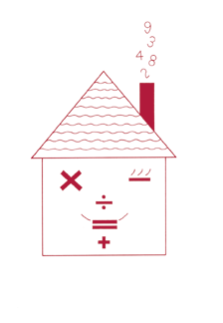


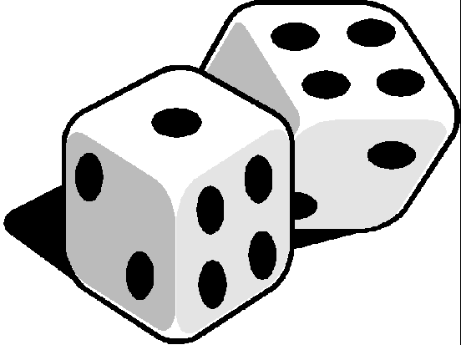
Fun activities to do at home
It is a known fact that playing card and board games can really
help children’s Maths. Adding dice scores, playing dominoes,
track or card games all help children’s Mathematics. Some of
the Year 3 objectives may be harder than they seem. For example, a child who can count up to 1000 may not know what each digit represents. In 784, for example, the ‘8’ is worth 80 not just 8. Equally, they may still have trouble saying a number which is 10 more than 98 or which number comes 30 before 215. Rapid recall of basic number facts is essential as they create good foundations for future maths concepts.
Times tables
Say together the three times table forwards, then backwards up to twelve
Ask your child questions, such as:
-Nine threes? -How many threes in 24?
-Six times three? - Twenty-seven divided by three?
-Three multiplied by six? -Three times what equals thirty-six?
Repeat with the two, four, five and eight times tables.
Can you tell the time?
Whenever possible, ask your child to tell you the time to the nearest 5minutes. Use a clock with hands as well as a digital watch or clock.
Ask: What time will it be one hour from now?
What time was it one hour ago?
Time your child doing various tasks, e.g. getting ready for school; tidying a bedroom; saying the 5 times, 2 times or 3 times table…
Ask your child to guess in advance how long they think an activity will take. Can they beat their time when they repeat it?
Number games
Roll a dice twice to make a two-digit number, e.g. if you roll a 6 and 4 this could be 64 or 46. Then ask your child to do one or more of these activities:
Count on or back from each number in tens.
Add 9 or 19 to each number in their head. (A quick way is to add 10 and then take away 1 or add 20 and subtract 1)
Double the number.

Slide 4
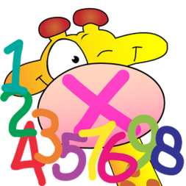


Times table race
You need two dice and a pile of counters.
Take turns to roll the two dice.
Multiply the two numbers and call out the answer.
If you are right, you win a counter. The first to get 10 counters wins.
Secret calculations
Ask your child to say a number, e.g. 43.
Secretly do something to it (e.g. add 30). Say the answer only, (e.g. 73)
Your child then says another number to you, (e.g.61). Do the same to that number and say the answer.
The child has to guess what you are doing to the number each time.
Shopping Maths
After you have been shopping, choose 6 different items each costing less than £2. Make a price label for each one, e.g. 39p, 78p. Shuffle the labels. Then ask your child to do one or more of these.
Place the labels in order, starting with the lowest.
Say which price is an odd number and which is an even number.
Add 9p to each price in their head.
Take 20p from each price in their head.
Say which coins to use to pay exactly for each item.
Choose any two of the items, and find their total cost.
Work out the change from £1, £2 or £5 for each item.
Guess my number
Choose a car number you can see , e.g. 592
Add 10 to the number in your head. Say the answer aloud.
Can your child guess which car you were looking at? If so he/she can have the next turn.
Cupboard Maths
Ask your child to look at the weights printed on jars, tins and packets in the food cupboard, e.g. tinned tuna 185g, tinned tomatoes 400g, jam 454g. Choose six items. Ask your child to put them in order. Is the largest item the heaviest?

