Slide 1



St Michael’s CE VA Primary School
Year 2
At St Michael’s CE VA Primary School our aim is to work in partnership with you to enhance your child’s progress and enjoyment of Maths! This leaflet is an aid to help you to support your child to develop their understanding of the range of Maths concepts they will cover while in school. It aims to offer ideas of fun activities to engage your child’s love of Maths at home.

Slide 2
During Year 2 most children will learn how to:
Count in steps of 2,3 and 5 from 0, and in 10 from any number forwards and backwards.
Recognise the place value of each digit in a two-digit number (tens and ones)
Compare and order numbers from 0 up to 100. Use < , > and = signs
Recall and use addition and subtraction facts to 20 fluently, and derive and use related facts up to 100
Add and subtract numbers using objects, pictures and mentally, including:
-A two-digit number and ones (21 +3)
-A two-digit number and tens (21 + 10)
-Two two-digit numbers (21 +13)
-Adding three one-digit numbers ( 7 + 3 + 2)
Recall and use multiplication and division facts for the 2,5and 10 multiplication tables, including recognising odd and even numbers.
Calculate mathematical statements for multiplication and division within the multiplication tables known and write them using the x, ÷ and = signs
Recognise, find, name and write fractions 1/3, 1/4 , 2/4 and 3/4 of a length, shape, set of objects or amount
Choose and use appropriate standard units to estimate and measure length/ height (m/cm); mass (kg/g); temperature (°C); capacity (litres/ml) using appropriate equipment.
Recognise and use symbols for pounds (£) and pence (p)
Find combinations of coins that equal the same amount of money
Solve practical problems involving addition and subtraction of money, including giving change
Tell and write the time to five minutes, including quarter past/to the hour
Know the number of minutes in a hour and hours in a day
Identify and describe the properties of 2D shapes, including the number of sides and lines of symmetry in a vertical line
Identify and describe the properties of 3D shapes, including the number of edges, vertices and faces.
Interpret and construct simple pictograms, tally charts, block diagrams and simple tables.

Slide 3
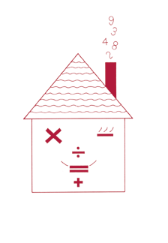

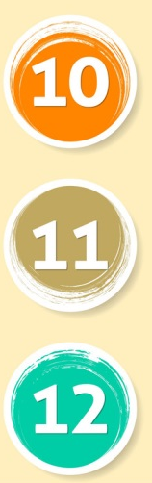
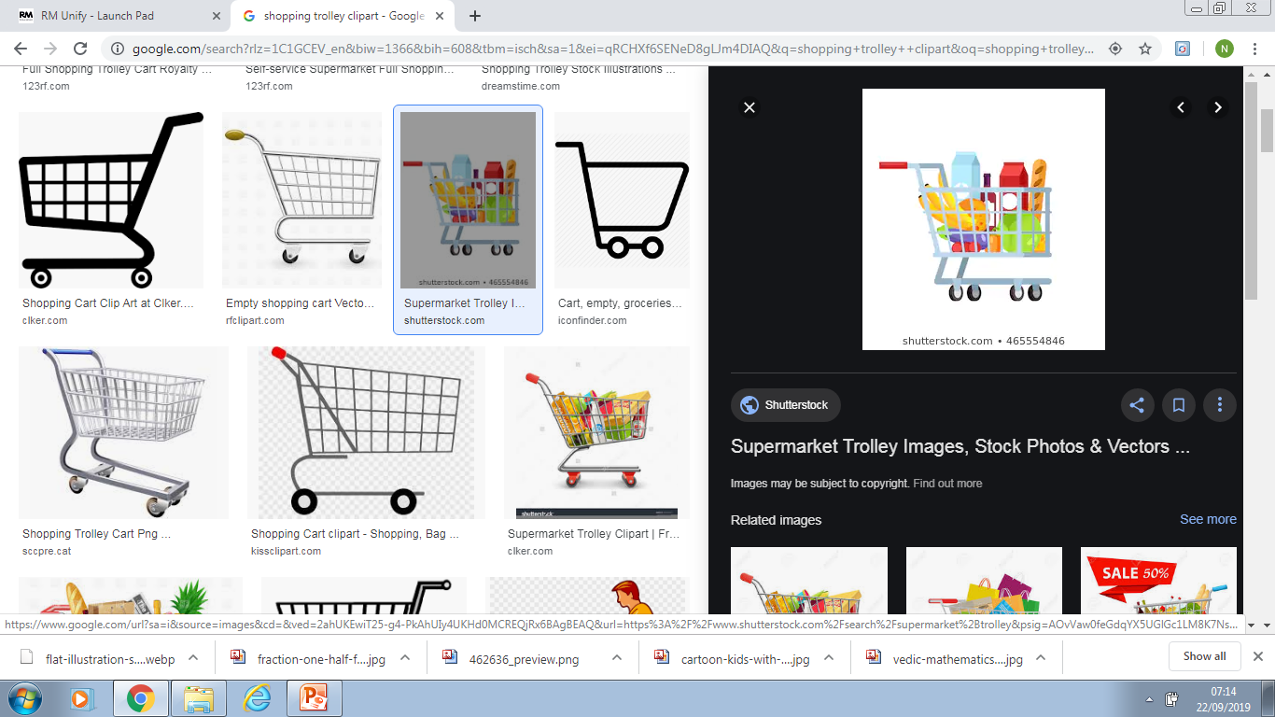
Fun activities to do at home
It is a known fact that playing card and board games can really
help children’s Maths. Adding dice scores, playing dominoes,
track or card games all help children’s Mathematics. Some of
the Year 2 objectives may be harder than they seem. For example, a child who can count up to 100 still may have trouble saying which number comes after 47 or which number comes before 50. Rapid recall of basic number facts is essential as they create good foundations for future Maths concepts.
Number facts
You need a 1-6 dice.
Take turns. Roll the dice. See how quickly you can say the number to add to the number on the dice to make 10.
If you are right, you score a point.
The first person to get 10 points wins.
You can extend this activity by making the two numbers total 20 or 50.
Circle trios
Draw four circles each on your piece of paper. Write four numbers between 3 and 18, one in each circle.
Take turns to roll a dice three times and add the three numbers
If the total is one of the numbers in your circles then you may cross it out.
The first to cross out all four circles wins.
Shopping Maths
After you have been shopping, choose 6 different items each costing less than £1. Make a price label for each one, e.g. 39p, 78p …
Shuffle the labels. Then ask your child to do one or more of these:
Place the labels in order, starting with the lowest
Say which price is an odd number and which is an even number
Add 9p to each price in their head. Take 20p from each price in their head.
Say which coins to use to pay exactly for each item
Choose any two of the items, and find their total costs
Work out the change from £1 for each item.

Slide 4


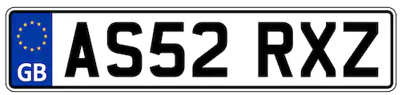

Subtraction
For this game you need a dice and some counters or small objects.
Start with a pile of objects in the middle. Count them.
Throw a dice. Say how many beans will be left if you subtract that number.
Then take the beans away and check if you were right!
Keep playing. The person to take the last bean wins!
Target number
Write a target number and then challenge them to try and make this answer is as many ways as possible. Begin with additions and subtractions but this can be extended to multiplication and division facts.
Here is an example:
Counting and timing actions
Provide plenty of opportunities to tell the time during the routine of the day.
Check your child can tell you how many minutes are in an hour and how many hours in a day.
Time how many jumps, skips, star jumps can be completed in a minute.
Put children in charge of letting everyone know when it is 10minutes before it is time to leave for school, dinner, etc…
Number Plate Bingo
Each person chooses a target number , e.g. 15
How many car numbers can you spot with 2 or 3 digits adding up to your target number e.g. K456 XWL – So 4 + 5 + 6 =15, BINGO!
Fractions
Use 12 buttons, or paper clips or Smarties...
Ask your child to find half of the 12 things by practically grouping objects.
Now find one quarter of the whole group.
Find one third of the whole group. Repeat with other numbers.

