Slide 1
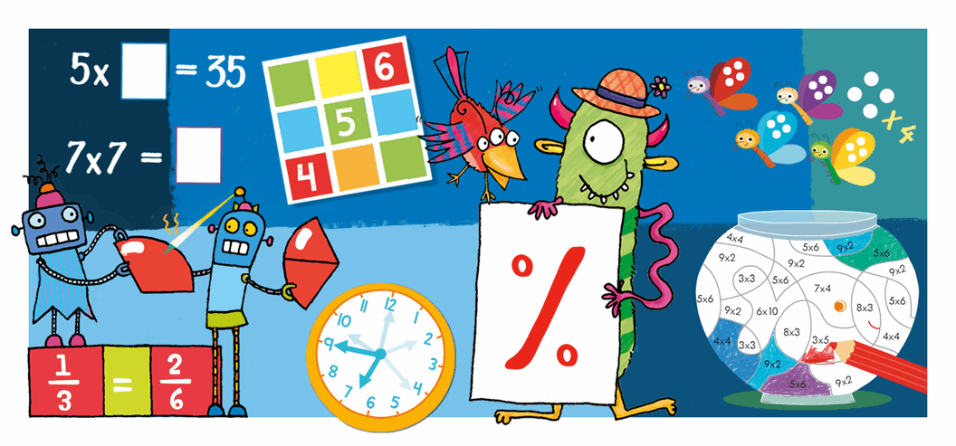
St Michael’s CE VA Primary School
Year 1
At St Michael’s CE VA Primary School our aim is to work in partnership with you to enhance your child’s progress and enjoyment of Maths! This leaflet is an aid to help you to support your child to develop their understanding of the range of Maths concepts they will cover while in school. It aims to offer ideas of fun activities to engage your child’s love of Maths at home.

Slide 2
During Year 1 most children will learn how to:
Count, read and write number to 100 in numerals;
Count in multiples of 2, 5 and 10
Count forwards and backwards, beginning from 0 or any given number
Identify one more and one less of a number
Represent numbers using objects and pictures
Use the language of : equal to, more than, less than, most, least
Read, write number sentences involving +, - and = signs
Represent and use number bonds and related subtraction facts up to 20
Add and subtract one-digit and two-digit numbers to 20
Solve one-step problems, and missing number problems such as 7= -9
Solve one-step problems involving multiplication and division, using objects, pictures and arrays with teacher support
Recognise, find and name a half as one of two equal parts and a quarter as one of four equal parts of an object, shape or quantity
Measure and begin to record the following:
-lengths and heights
-mass/weight
-capacity and volume
-time (hours, minutes, seconds)
Compare, describe and solve practical problems involving measurements
-e.g. longer/shorter, heavier than/ lighter than, quicker/ slower
Recognise and know the value of different coins and notes
Understand language relating to days of the week, months and years
Tell the time to the house and half past the hour
Recognise and name common 2D and 3D shapes
Describe position, direction and movement.

Slide 3
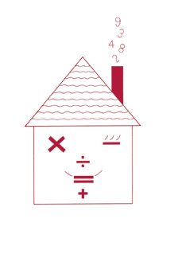
Fun activities to do at home
It is surprising but true that playing games can really help children’s Maths. Adding dice scores, playing dominoes, track or card games all help children’s Mathematics.
Secret numbers
Write the numbers 0 to 20 on a sheet of paper.
Ask your child secretly to choose a number on the paper. Then ask him/her some questions to find out what the secret number is ,
-e.g. Is it less than 10? Is it between 10 and 20? Does it have a 5 in it? Is it odd/even?
Once you have guessed the number, it is your turn to choose a number. Your child asks the questions. For an easier game, use numbers up to 10. For a harder game, use only 5 questions, or use bigger numbers.
Track games
Make a number track to 20, or longer. Make it relevant to your child’s interests- sea creatures, space, fairies, monsters…. Then play games on it.
Throw a dice. Move along that number of spaces. BUT before you move, you must work out what number you will land on. if you are wrong, you don’t move! The winner is the first to land exactly on 20. now play going backwards to 1.
Throw a dice. Find a number on the track that goes with the number thrown to make either 10 or 20. put a counter on it, e.g. you throw a ‘4’ and put a counter on either 6 or 16. if someone else’s counter is there already, you may replace it with yours! The winner is the first person to have a counter on 8 different numbers.

Slide 4
Adding circles
For this game, you need a dice, pencil and paper.
Each of you should draw four circle on your piece of paper. Write a different number between 2 and 12 in each circle.
Roll the dice twice. Add the two numbers.
If the total is one of the numbers in your
circles, then you may cross it out.
The first person to cross out all four circles wins.
Target number
You could ask them to write a number, for example the age they are on a piece of paper. Then challenge them to try to make this using as many different additions and subtractions as they can.
Counting and timing actions
See how many skips, catches, goals, circuits you can do without stopping. Can you beat yesterday’s score? How many seconds does it take you to get dressed/undressed, do a circuit, 20 skips, etc? Can you do it quicker than last time? Time with a timer and record on a number line.
Shape hunts
Allow the children to hunt for shapes in their local environment, at home or out and about. What shape is this plate, this mirror, the bath mat, the tea towel, the window, the door, the red traffic light, and so on.
They could also be given ‘detective kits’ (either images of simple descriptions) to help with their identification.
Extend to 3D shapes- How many cuboids, spheres and cylinders you can spot? Which did you see most of?
Playing number board games
Games like Snakes and Ladders help to increase children’s understanding of the value of a number as well as counting.

